Slide 1
Taking the Complexity out of Training Needs Assessment:
A proven and a Practical Approach
Terrence Donahue
Corporate Director, Learning, Emerson Electric

Slide 2
Taking the Complexity out of Training Needs Assessment:
A proven and a Practical Approach
Terrence Donahue
Corporate Director, Learning, Emerson Electric

Slide 3
Organizational Learning and Performance
Developmental
Needs Assessment
Education
Needs Assessment
Training
Needs Assessment
Attribution: Laird, Dugan; Approaches to Training and Development, Addison-Wesley Publishing Company, Inc., Reading, MA 01867, 1985
Nadler, Leonard Designing Training Programs: The Critical Events Model, Addison-Wesley, Inc., Reading, MA 01867, 1982

Slide 4
Organizational Learning and Performance
Development
Education
Training
Attribution: Laird, Dugan; Approaches to Training and Development, Addison-Wesley Publishing Company, Inc., Reading, MA 01867, 1985
Nadler, Leonard Designing Training Programs: The Critical Events Model, Addison-Wesley, Inc., Reading, MA 01867, 1982

Slide 5
Organizational Learning and Performance
What are the differences between Training, Education, and Development, and why do these differences matter when conducting a needs assessment?
Development
Education
Training

Slide 6
Organizational Learning and Performance
Development
Experiences and targeted assignments that grow you
Education
Knowledge and skill for your next role
Training
Knowledge and skill for what you do now
Attribution: Laird, Dugan; Approaches to Training and Development, Addison-Wesley Publishing Company, Inc., Reading, MA 01867, 1985
Nadler, Leonard Designing Training Programs: The Critical Events Model, Addison-Wesley, Inc., Reading, MA 01867, 1982

Slide 7
Organizational Learning and Performance: The 70:20:10 Framework
70 PERCENT of your development may occur through experience and targeted developmental assignments 20 PERCENT of your development may occur through learning from others.
10 PERCENT of your development may occur through focused training.
Attribution: Morgan McCall, Michael Lombardo and Robert Eichinger, Center for Creative Leadership (CCL) 1996

Slide 8
When should we provide training to employees?
Something New
Mandated
Job Performance Discrepancies
A NEW…
Employee
Promotion
Product
Procedure
Policy
Process
Equipment
Strategic Initiative
Change
IT IS REQUIRED…
Compliance
Legal
Certification
Customer Requirement
What is the performance discrepancy?
What is the cause of the discrepancy?
How can it be fixed?
Is training the right solution?
What Training do they need?
Do they need Training?

Slide 9
Two Very Important Questions in a Training Needs Assessment
One Question to Never Ask...
One Question to Always Ask
Do you need Training?
What do you think you need to perform your job tasks better?

Slide 10
Three Occasions to Determine Training Needs
1 | Requests for Training | Determine if Training is a solution for a performance discrepancy when it is identified that employees lack knowledge and skill to perform as expected.
2 | Determining Future Needs | Determine the knowledge and skills that will be needed in the future and how training can help equip employees with these skills.
3 | Evaluating Existing Curriculum | Determine if training solutions in your current curriculum portfolio are still necessary, relevant, and effective.
Attribution: The Performance Maker Group LLC Copyright 2009 Milwaukee, WI Used with permission
Job Aid Page 2

Slide 11
Three Occasions to Determine Training Needs
1 | Requests for Training | Reactive
2 | Determining Future Needs | Proactive
3 | Evaluating Existing Curriculum | Evaluative
Attribution: The Performance Maker Group LLC Copyright 2009 Milwaukee, WI Used with permission
Job Aid Page 2

Slide 12
Three Occasions to Determine Training Needs
1 | Requests for Training | Determine if Training is a solution for a performance discrepancy when it is identified that employees lack knowledge and skill to perform as expected.
2 | Determining Future Needs | Determine the knowledge and skills that will be needed in the future and how training can help equip employees with these skills.
3 | Evaluating Existing Curriculum | Determine if training solutions in your current curriculum portfolio are still necessary, relevant, and effective.
Attribution: The Performance Maker Group LLC Copyright 2009 Milwaukee, WI Used with permission
Job Aid Page 2

Slide 13
Situation 1: Request-based Training Needs Assessment
Expected Performance – Actual Performance = Performance Discrepancy
What is the discrepancy?
What is/are the cause(s)?
How can we fix it?
Attribution: The Performance Discrepancy: Allison Rosette, 1987
The Job Performance Puzzle, The Performance Maker Group LLC Copyright 2009 Milwaukee, WI Used with permission.
Job Aid Page 3

Slide 14
Situation 1: Request-based Training Needs Assessment
Expected Performance – Actual Performance = Performance Discrepancy
The only time you should offer training as a solution to a job performance discrepancy is when you have confirmed that poor performance is caused by a lack of knowledge and skill.
The Job Performance Puzzle, The Performance Maker Group LLC Copyright 2009 Milwaukee, WI Used with permission.
Job Aid Page 3

Slide 15
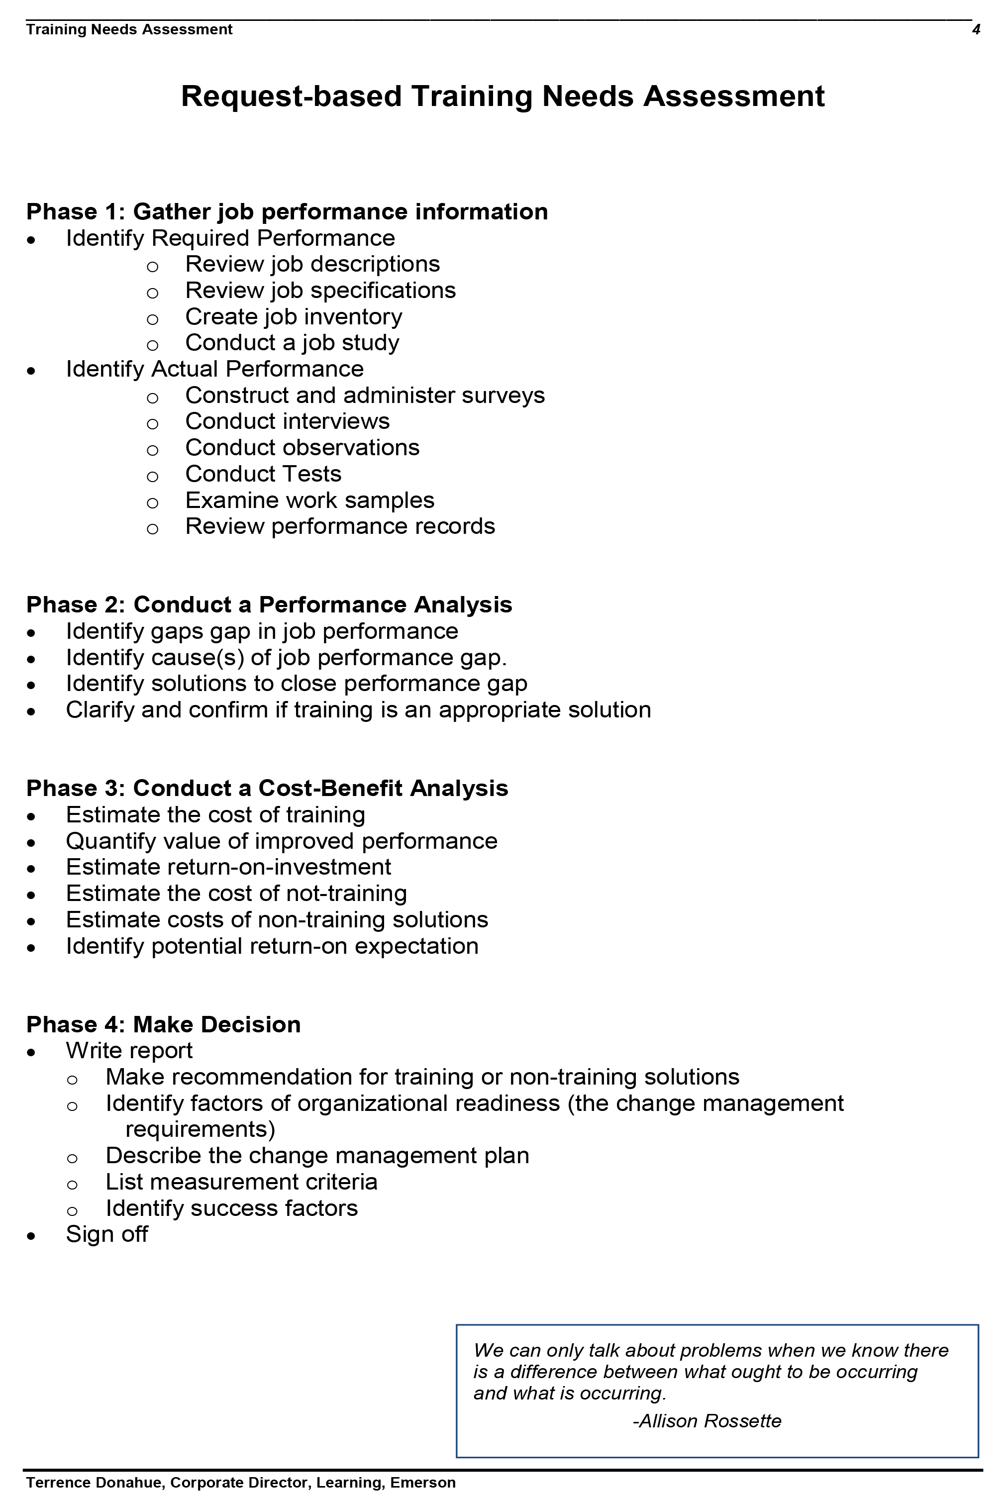
Situation 1: Request-based Training Needs Assessment
The Four Phases of a Request-based TNA:
Phase 1: Gather Job Performance Data
Phase 2: Conduct a Performance Analysis
Phase 3: Conduct a Cost-Benefit Analysis
Phase 4: Make Decision
Job Aid Page 4

Slide 16
Situation 1: Request-based Training Needs Assessment
The Four Phases of a Request-based TNA:
Phase 1: Gather Job Performance Data
Phase 2: Conduct a Performance Analysis
Phase 3: Conduct a Cost-Benefit Analysis
Phase 4: Make Decision
Job Aid Page 4

Slide 17
Situation 1: Request-based Training Needs Assessment
The Four Phases of a Request-based TNA:
Phase 1: Gather Job Performance Data
Phase 2: Conduct a Performance Analysis
Phase 3: Conduct a Cost-Benefit Analysis
Phase 4: Make Decision
Job Aid Page 4

Slide 18
Situation 1: Request-based Training Needs Assessment
The Four Phases of a Request-based TNA:
Phase 1: Gather Job Performance Data
Phase 2: Conduct a Performance Analysis
Phase 3: Conduct a Cost-Benefit Analysis
Phase 4: Make Decision
Job Aid Page 4

Slide 19
Three Occasions to Determine Training Needs
1 | Requests for Training | Determine if Training is a solution for a performance discrepancy when it is identified that employees lack knowledge and skill to perform as expected.
2 | Determining Future Needs | Determine the knowledge and skills that will be needed in the future and how training can help equip employees with these skills.
3 | Evaluating Existing Curriculum | Determine if training solutions in your current curriculum portfolio are still necessary, relevant, and effective.
Attribution: The Performance Maker Group LLC Copyright 2009 Milwaukee, WI Used with permission
Job Aid Page 5

Slide 20
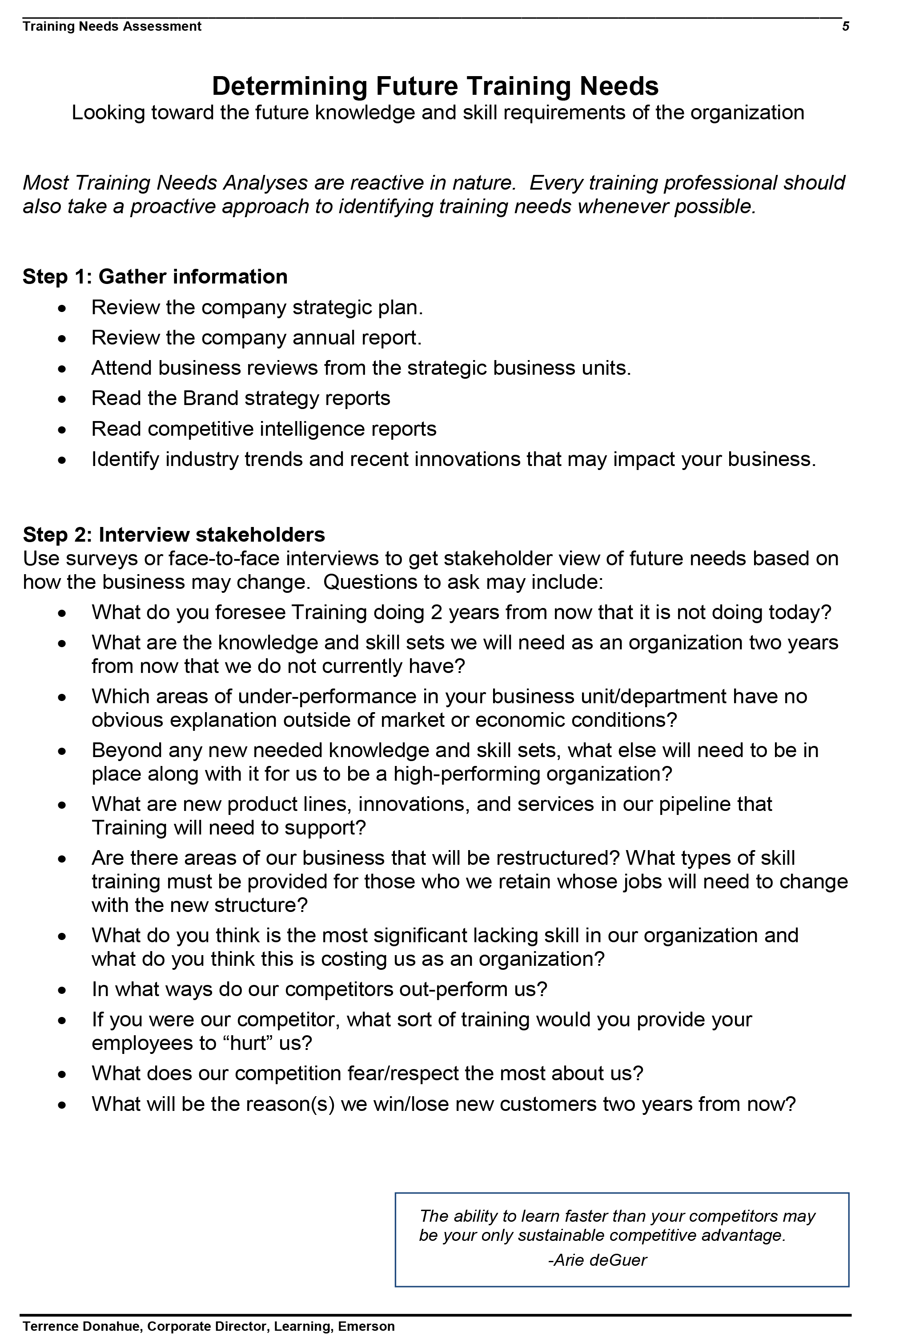
Situation 2: Determining Future Training Needs
Phase 1: Gather Information
Phase 2: Interview Stakeholders
Phase 3: Analyze Information
Phase 4: Write Proposal
Job Aid Page 5

Slide 21
Situation 2: Determining Future Training Needs
Phase 1: Gather Information
Phase 2: Interview Stakeholders
Phase 3: Analyze Information
Phase 4: Write Proposal
Job Aid Page 5

Slide 22
Situation 2: Determining Future Training Needs
Phase 1: Gather Information
Phase 2: Interview Stakeholders
Phase 3: Analyze Information
Phase 4: Write Proposal
Job Aid Page 6

Slide 23
Situation 2: Determining Future Training Needs
Phase 1: Gather Information
Phase 2: Interview Stakeholders
Phase 3: Analyze Information
Phase 4: Write Proposal
Job Aid Page 6

Slide 24
Three Occasions to Determine Training Needs
1 | Requests for Training | Determine if Training is a solution for a performance discrepancy when it is identified that employees lack knowledge and skill to perform as expected.
2 | Determining Future Needs | Determine the knowledge and skills that will be needed in the future and how training can help equip employees with these skills.
3 | Evaluating Existing Curriculum | Determine if training solutions in your current curriculum portfolio are still necessary, relevant, and effective.
Attribution: The Performance Maker Group LLC Copyright 2009 Milwaukee, WI Used with permission
Job Aid Page 7

Slide 25
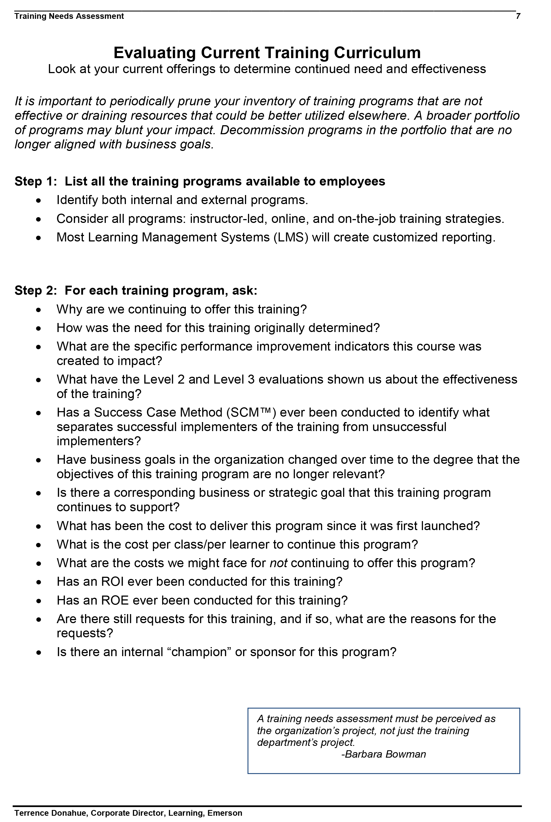
Situation 3: Evaluating Existing Curriculum
Phase 1: List all Training Courses
Phase 2: Analyze Each Training Course
Phase 3: Determine to Continue or Discontinue
Job Aid Page 7

Slide 26
Situation 3: Evaluating Existing Curriculum
Phase 1: List all Training Courses
Phase 2: Analyze Each Training Course
Phase 3: Determine to Continue or Discontinue
Job Aid Page 7

Slide 27
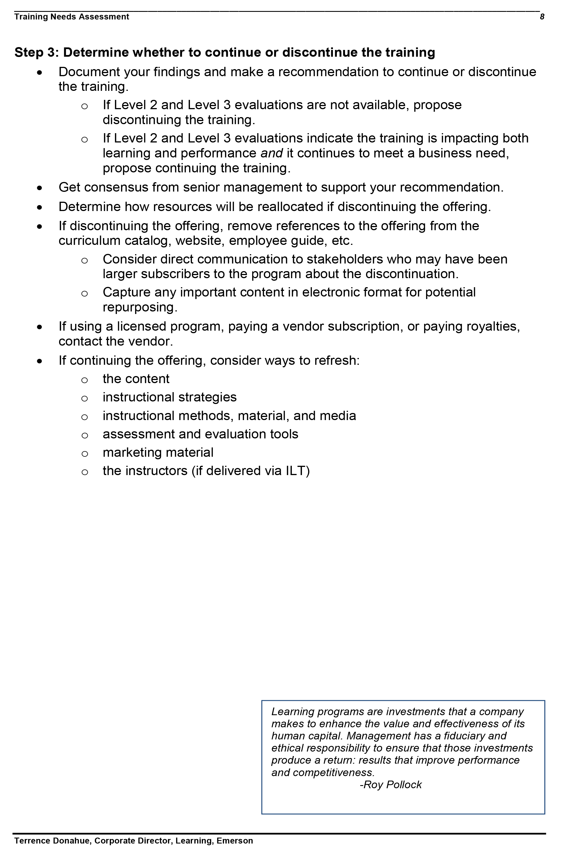
Situation 3: Evaluating Existing Curriculum
Phase 1: List all Training Courses
Phase 2: Analyze Each Training Course
Phase 3: Determine to Continue or Discontinue
Job Aid Page 8

Slide 28
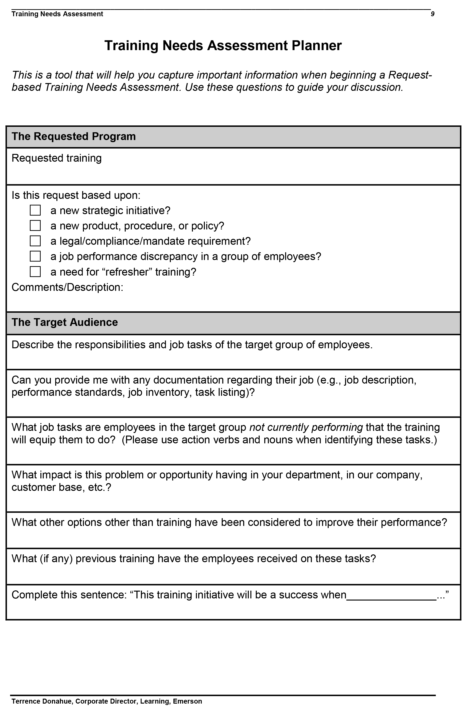
Use the Request-based Needs Assessment Planner
The Requested Program
The Target Audience
The Expected Outcomes
Job Aid Page 9

Slide 29
Use the Request-based Needs Assessment Planner
The Requested Program
The Target Audience
The Expected Outcomes
Job Aid Page 9

Slide 30
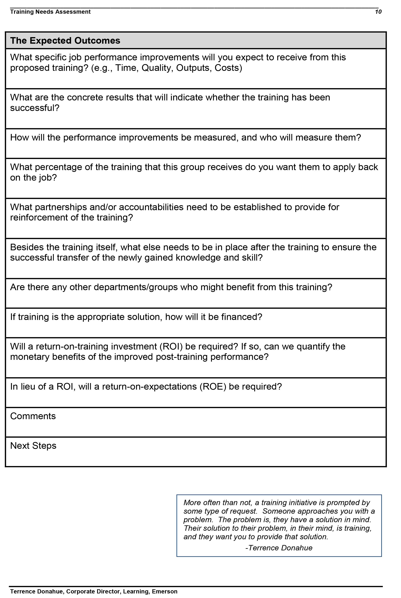
Use the Request-based Needs Assessment Planner
The Requested Program
The Target Audience
The Expected Outcomes
Job Aid Page 10

Slide 31
Three Occasions to Determine Training Needs
1 | Requests for Training | Determine if Training is a solution for a performance discrepancy if it is identified that employees lack knowledge and skill to perform as expected.
2 | Determining Future Needs | Determine the knowledge and skills that will be needed in the future and how training can help equip employees with these skills.
3 | Evaluating Existing Curriculum | Determine if training solutions in your current curriculum portfolio are still necessary, relevant, and effective.
Attribution: The Performance Maker Group LLC Copyright 2009 Milwaukee, WI Used with permission

Slide 32
Connecting the front-end assessment with the back-end evaluation
Level 4: Results
Has Training Changed Things?
Level 3: Behavior
Are you doing it?
Level 2: Learning
Did you learn it?
Level 1: Reaction
Did you like it?
Attribution: Kirkpatrick, Donald and James D. Kirkpatrick, Evaluating Training Programs: The Four Levels (3rd Edition)Barrett-Koehler, San Francisco, CA, 2006
”The Job Performance Puzzle”, Copyright 2009 The Performance Maker Group LLC. Milwaukee, WI Used with permission.

Slide 33
Connecting the front-end assessment with the back-end evaluation
Level 4: Results
Has Training Changed Things?
Level 3: Behavior
Are you doing it?
Level 2: Learning
Did you learn it?
Level 1: Reaction
Did you like it?
What tools do you use to gather data on each of these four levels of evaluation?
Attribution: Kirkpatrick, Donald and James D. Kirkpatrick, Evaluating Training Programs: The Four Levels (3rd Edition)Barrett-Koehler, San Francisco, CA, 2006
”The Job Performance Puzzle”, Copyright 2009 The Performance Maker Group LLC. Milwaukee, WI Used with permission.

Slide 34
The Missing Link in Evaluating Training
Expected Performance – Actual Performance = Performance Discrepancy
Measuring the front-end
(Training Needs Assessment)
Measuring the back-end
(Kirkpatrick 4 Levels)
Surveys
Interviews
Observations
Tests
Work Samples
Job Performance Records
Surveys
Interviews
Observations
Tests
Work Samples
Job Performance Records

Slide 35
Questions
Comments

Slide 36
Thank you!

Slide 37
SU1000
Taking the Complexity Out of Training Needs Assessment:
A Practical and Proven Approach
M212
Successful Leadership Transitions: How a Global Company Equips Its Leaders for New Roles
Terrence Donahue, Corporate Director of Learning, Emerson
&
Michael Watkins, President, Genesis Advisers, former faculty member at Harvard Business School and author of the international bestseller The First 90 Days

